Slide 1
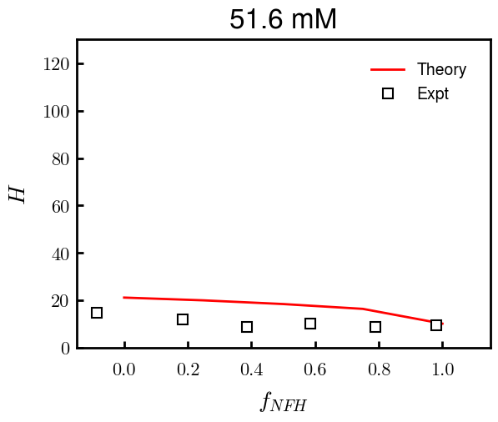
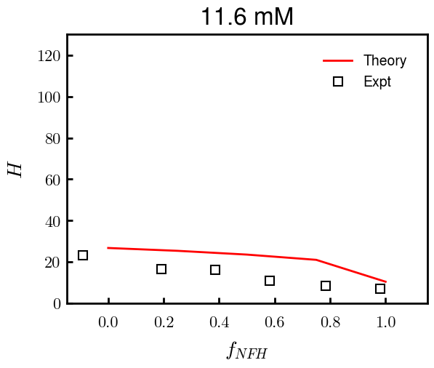
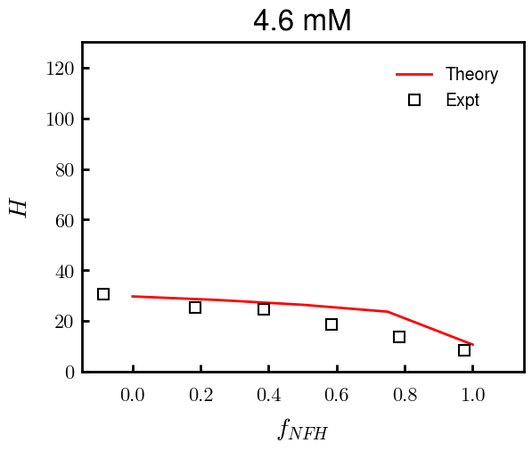
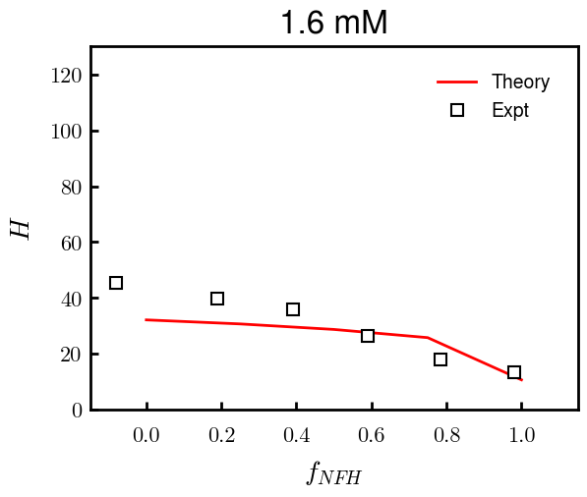
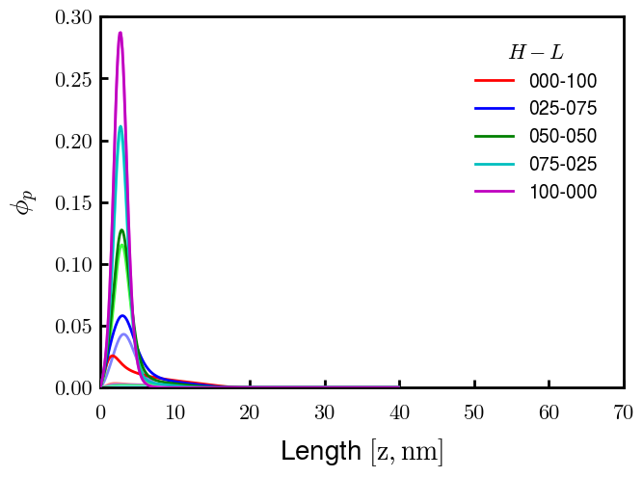
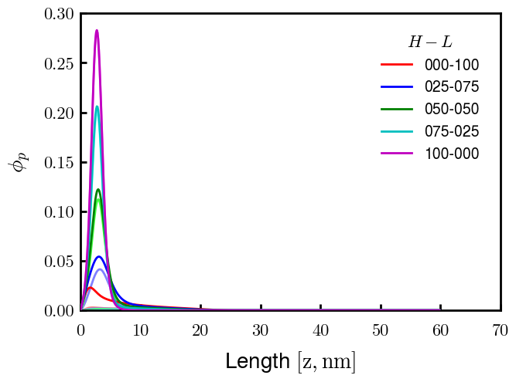
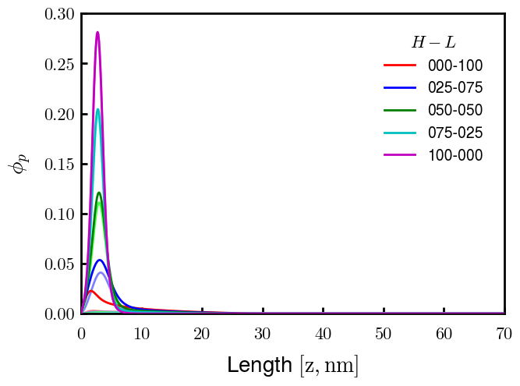

Binary NFH:NFL; sigma_total = 0.0344 c/nm2; bv = (0.6, 0.05)

Slide 2
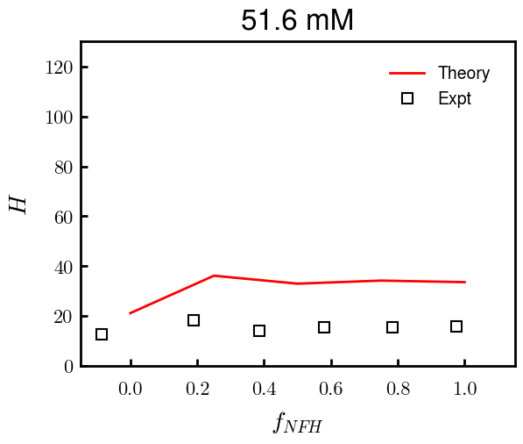
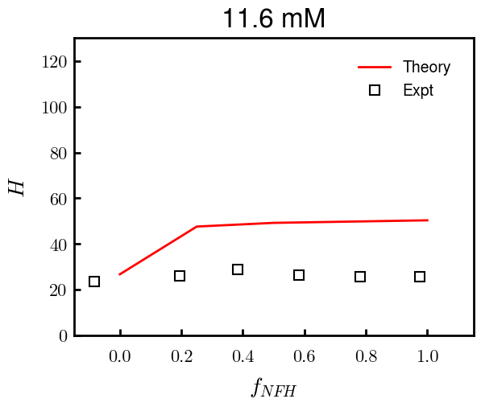
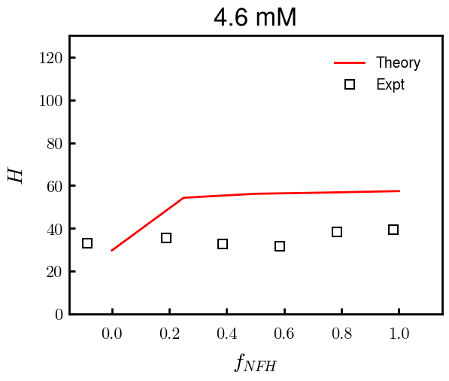
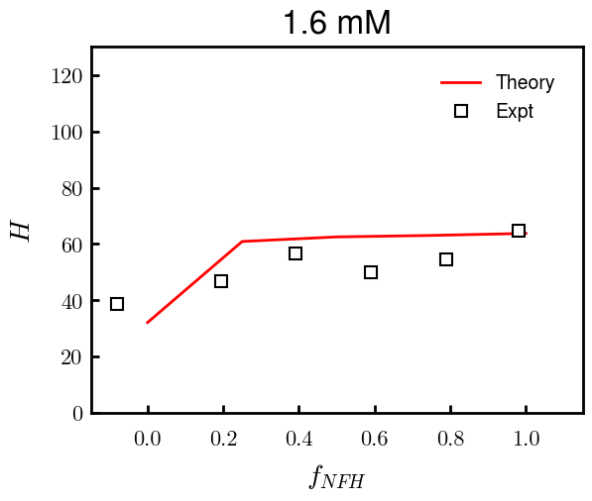
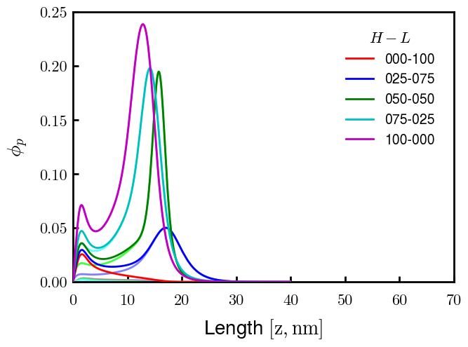
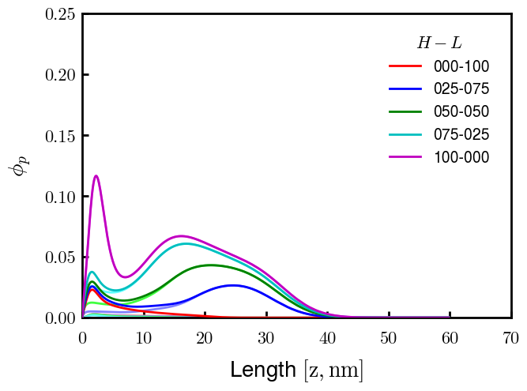
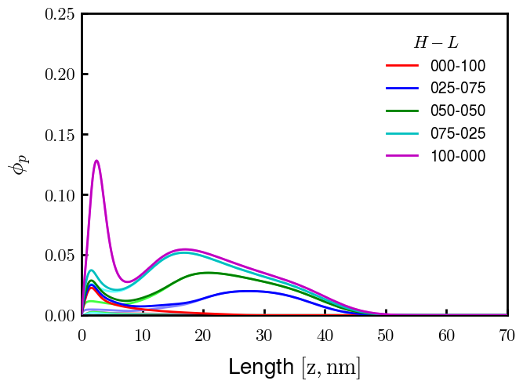
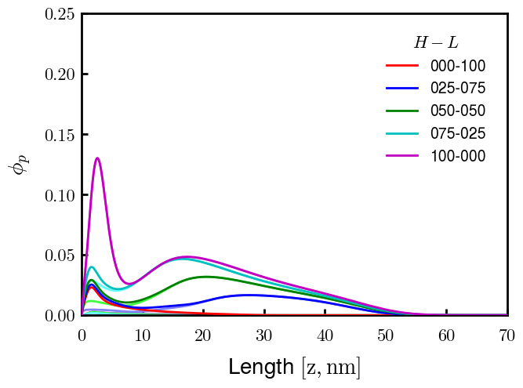
Binary pNFH:NFL; sigma_total = 0.0344 c/nm2; bv = [(0.6, 0.15), (0.6, 0.05)]
F50: PROG

Slide 3
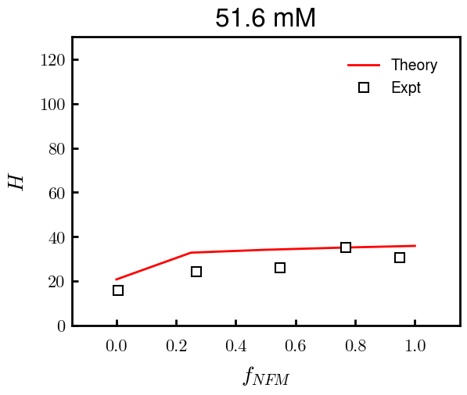
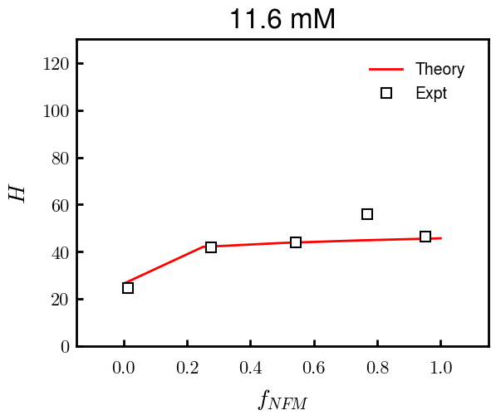
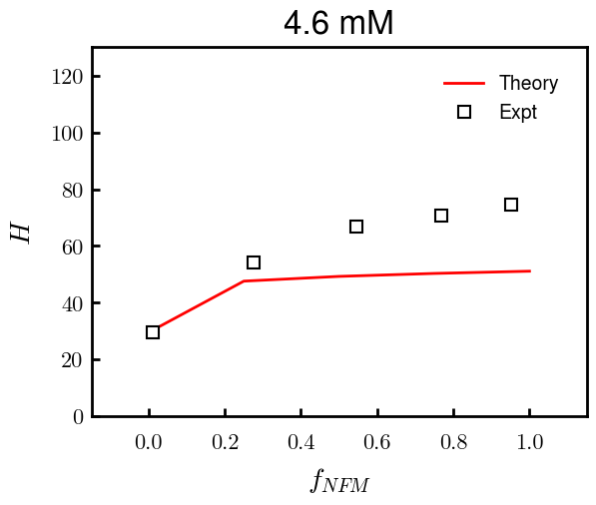
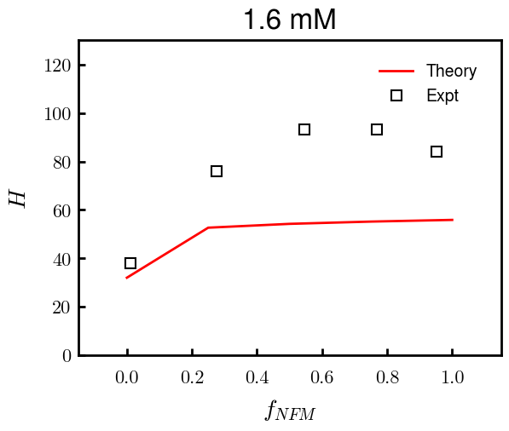
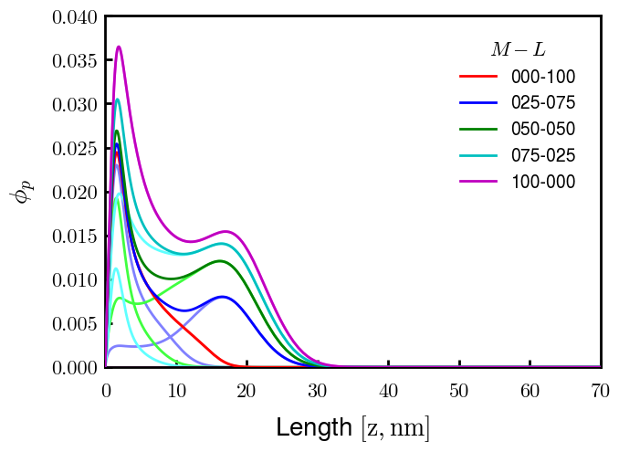
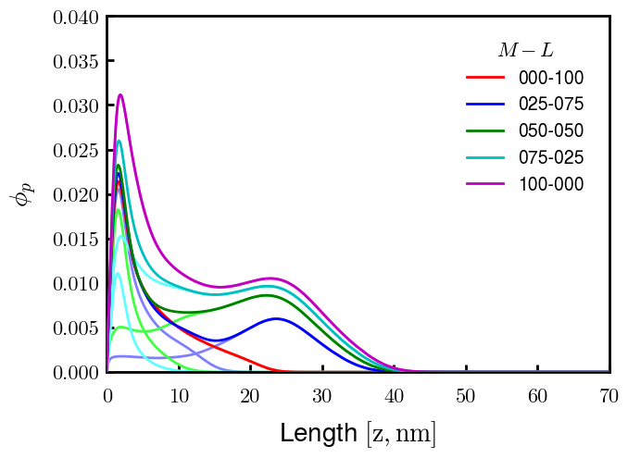
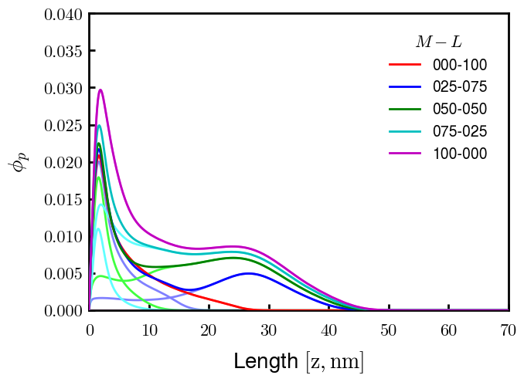
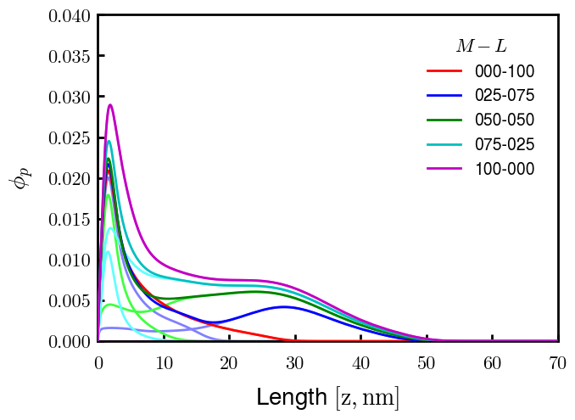
Binary NFM:NFL; sigma_total = 0.0315 c/nm2; bv = (0.6, 0.05)

Slide 4
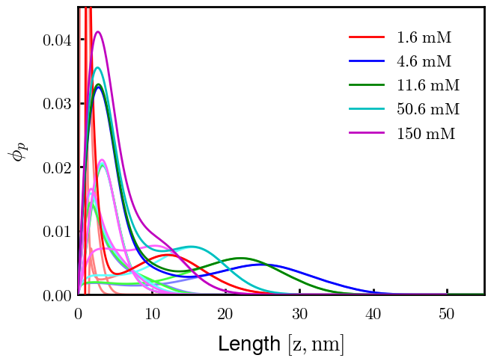
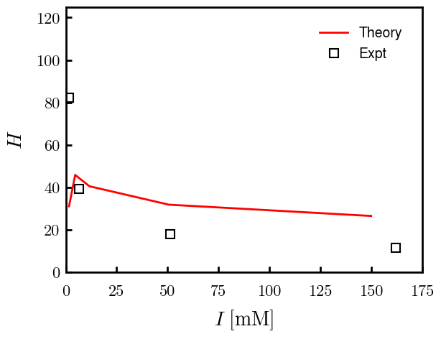
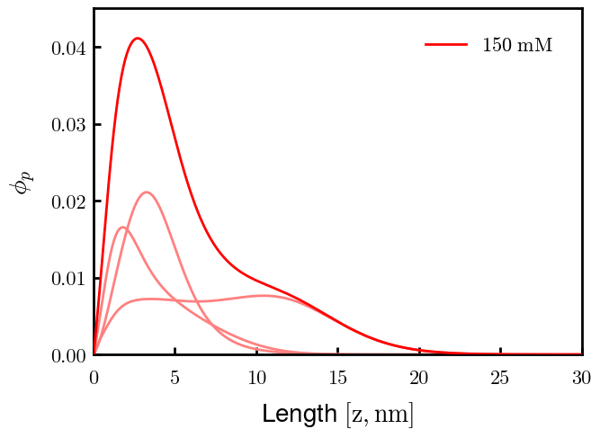
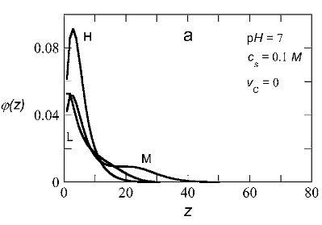
Rerunning 1.6, 4.6 mM

Slide 5
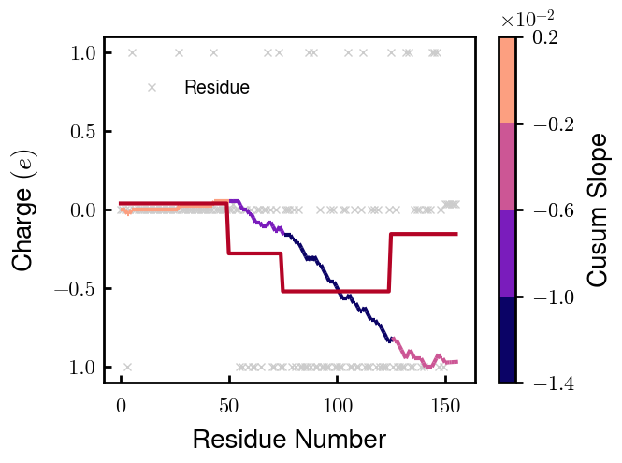
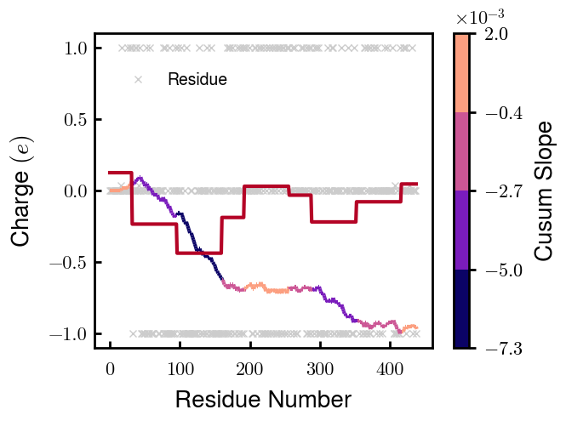

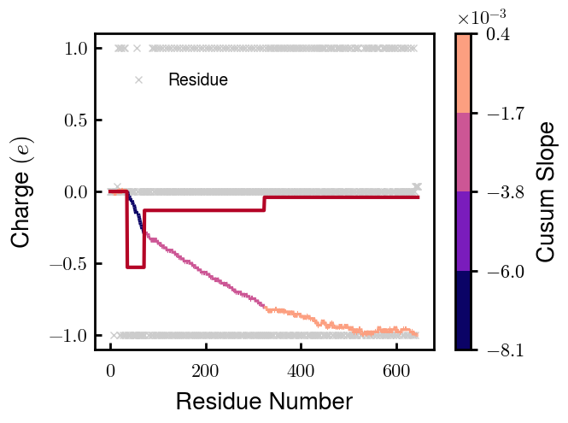
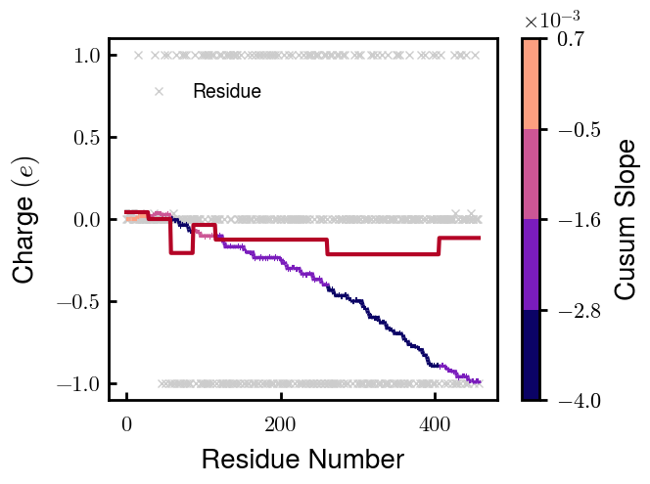
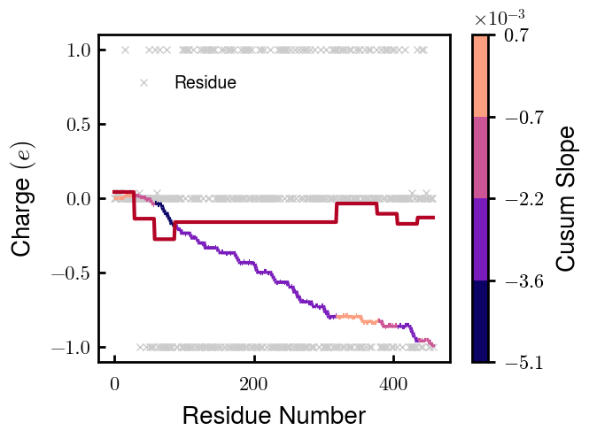
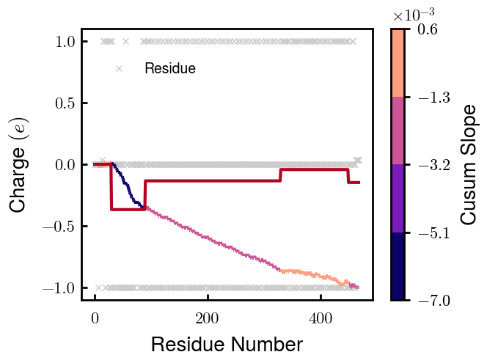
NFL
NFM
NFH
pNFH
NFM_S1
NFM_S2
pNFH_DE

Slide 6
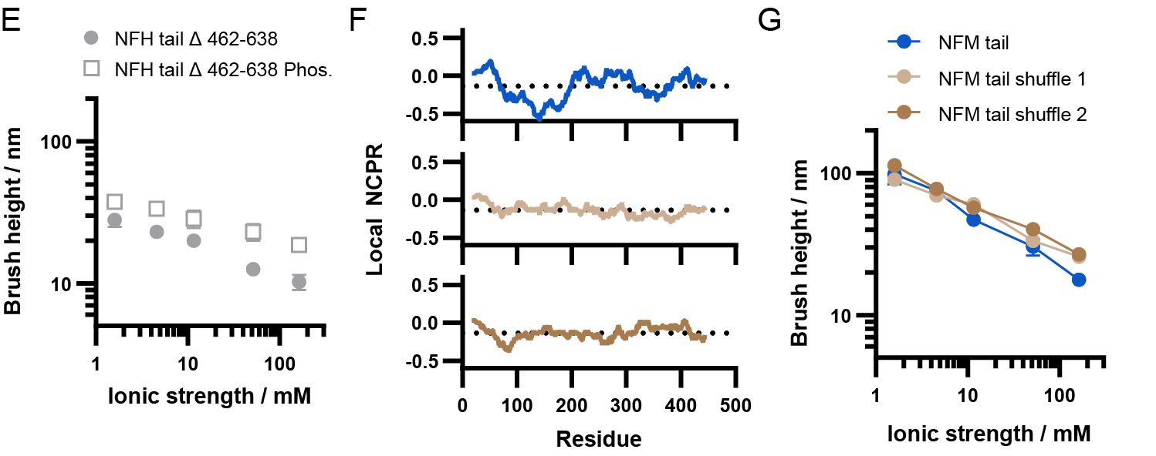
NFM_S1
NFM_S2

Slide 7
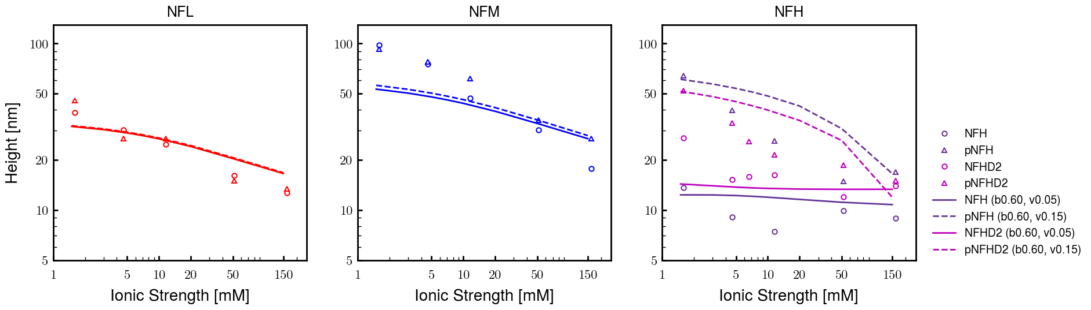
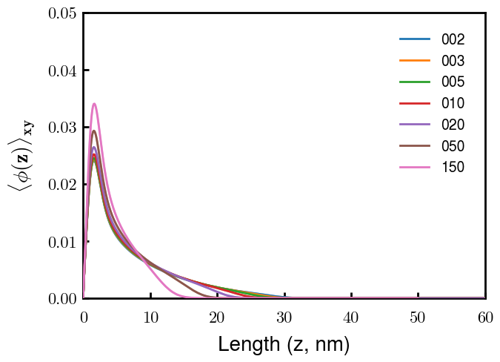
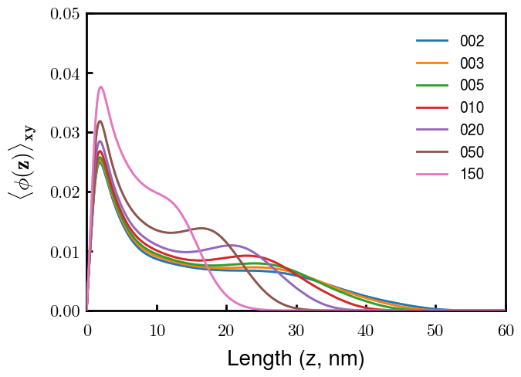
NFL
NFM
Next slide
Notes
pNFM running now; NFHb60v05c150 (cm225) running now
All non-phos same b,v
Phos L, M same as non-phos (few KsP)
Phos H 0.05 → 0.15 nm3
Potential improvements
Recheck pNFH(D2); no better option?
Recheck NFM; no better reasoning than b(s)?

Slide 8
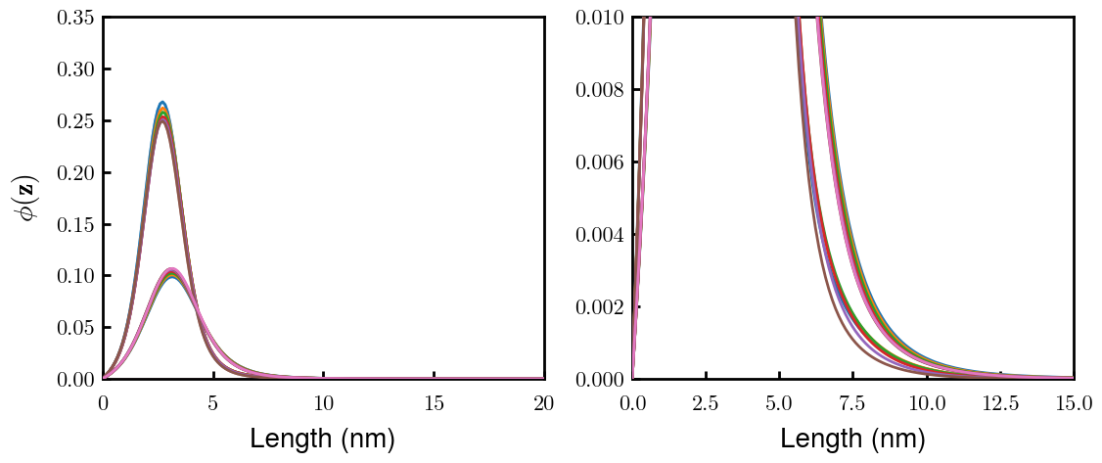
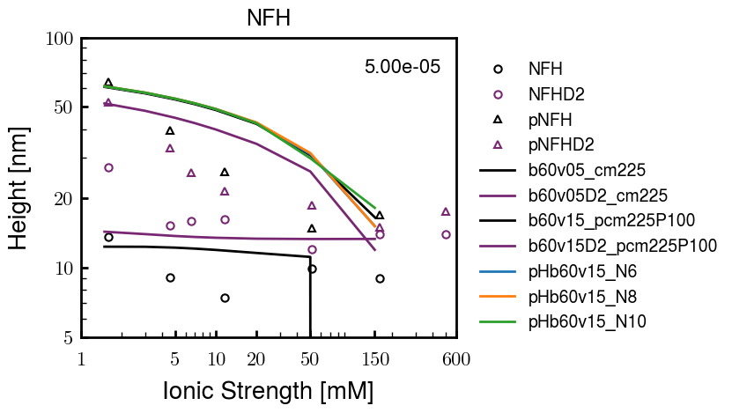
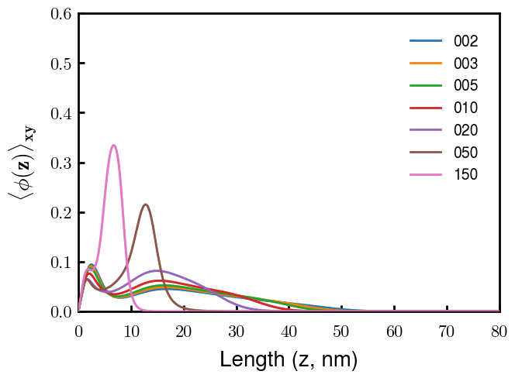
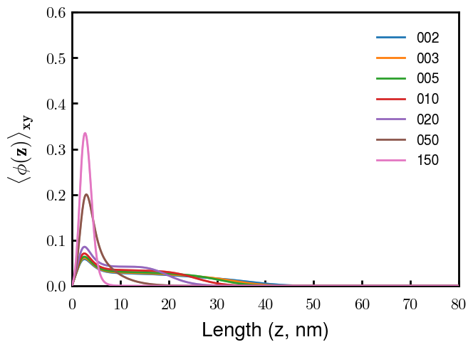
(p)NFH(D2)
NFH
NFHD2
pNFH
pNFHD2
(v = -1)
Points
v05 → v15 after phosphorylation
No condensed multilayer but worse fit

Slide 9
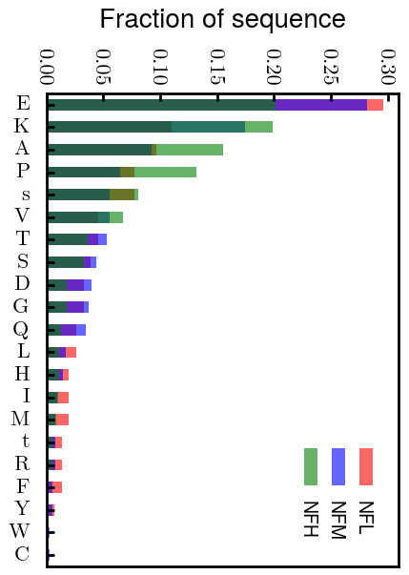
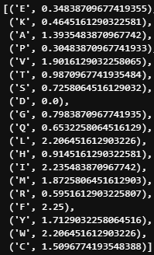
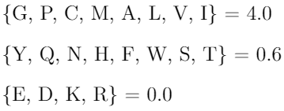
Chi (scaled)
Chi (BM 2023)
D: 3.65 (-1.00e);
E: 4.25 (-1.00e);
K: 10.53 (1.00e);
R: 12.48 (1.00e);
H: 6.00 (0.035e)
Biggest discrepancies between scaled and Zhulina: P (0.30 → 4.00), K (0.46 → 0.00), R (0.60 → 0.00)
(PKR has effect on pNFH; isolate P—currently seems too hydrophobic)

Slide 10
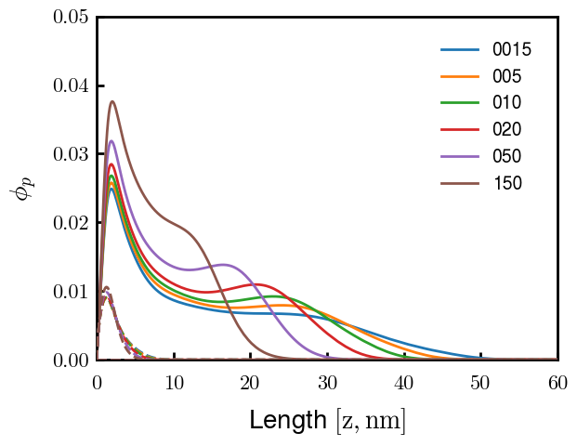
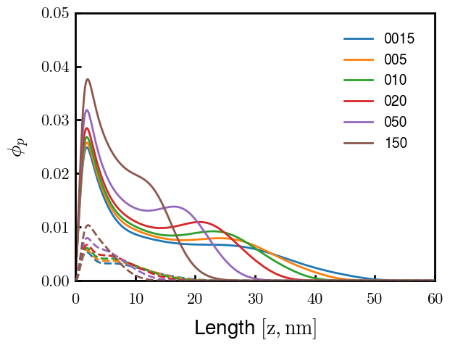
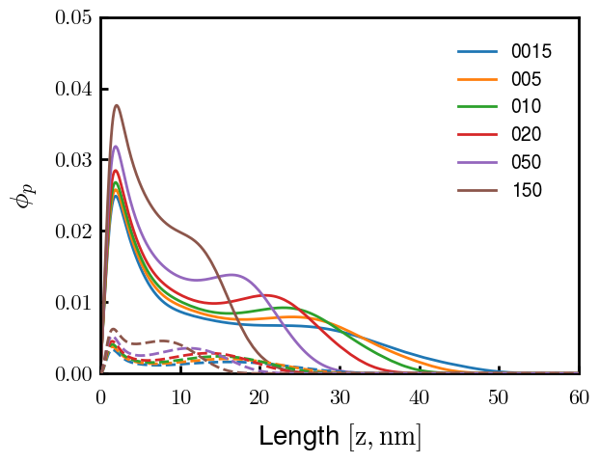
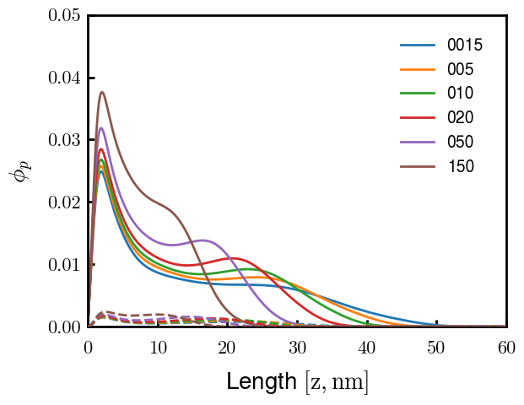
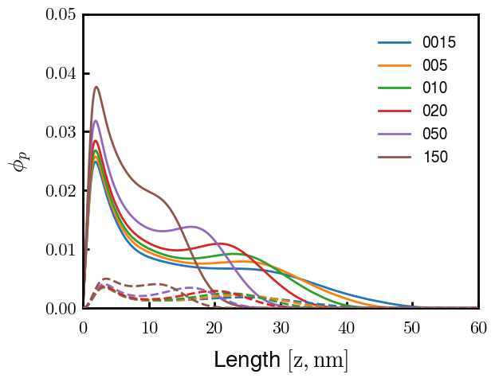

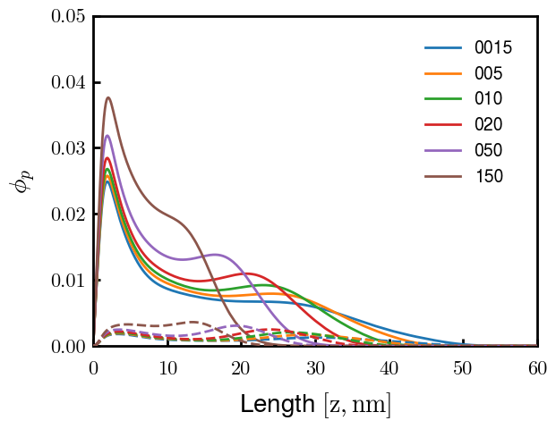


3
4
1
2
6
7
5
8
9

Slide 11



Other fits
pNFH P study next slide

Slide 12



Slide 13





pHb60v15_PKR
pHb60v15_P
pHb60v10_PKR
pHb60v10_P
PKR identified as amino acids with high discrepancies between expt and Zhulina bins
P isolated and good trend (change P to max, 2.25)
Even though better H, some conformational changes. Try to avoid by decreasing (in prog).
Single outer peak may not be bad— “flower” conf?
At the very least, increase high cs height and check NFHD2 (and eventually NFL, NFM)
Ensure effect does not ruin NFH(D2) (after screening)

Slide 14




Slide 15




Pr100

Slide 16





Slide 17


Try approaching surface

Slide 18



NFH (original); 31, 4
NFHD2; 40, 4
D2: delete 36-72
Rerun alg on D2
NFH (phos); 36, 4
NFHD2 (phos); 33, 4
Note: not currently doing this

Slide 19



Best fit w/ consistent chi_max
NFH
NFHD2
pNFH
(v = -1)
Points
v05 → v25 after phosphorylation
Bilayer (trilayer for 5?) pNFH morphology

Slide 20


Same params as prev. w/ diff thresh

Slide 21




Find best without multilayer
pNFH
pNFH
(v = -1)
(v = -1)
Multilayer at 20

Slide 22

Best pNFH scaling fit (no regard to realistic)
pNFH
(v = -1)
Points
v05 → v25 after phosphorylation
cm200 → cm250 after phospho
Multilayer
Phospho < native

Slide 23






Native NFH

Slide 24







NFHD2

Slide 25




pNFH(D2)
4e-03

Slide 26





1e-06
4e-03
norm
4e-03
Try to bring pNFH down → {cmXX + PXX} only choice
norm
4e-03

Slide 27




3e-04
3e-04
3e-04

Slide 28





Heights.params : b60v05 cm200
norm
1e-06
1e-05
1e-04
4e-03

Slide 29






Heights.params : b60v05 cm250
norm
ylog
norm
ylin
1e-06
1e-05
1e-04
5e-03

Slide 30




Heights.params: b60v10 cm{200, 225}
norm
1e-06
1e-05
1e-04
5e-03

Slide 31



Slide 32

 | Slope Bins 4 | Smear Count 25
Block number | Alpha w/ Henderson Hasselbalch | Chi Chi_max = 2.2
[0 50] | 0.040012 | 1.160000
[50 75] | -0.278451 | 0.720000
[75 125] | -0.519707 | 0.608000
[125 156] | -0.154453 | 0.529032

Slide 33

 | Slope Bins 4 | Smear Count 31
Block number | Alpha w/ Henderson Hasselbalch | Chi Chi_max = 2.2
[0 31] | 0.001103 | 0.922581
[31 62] | -0.386873 | 0.703226
[62 93] | -0.290146 | 0.967742
[93 496] | 0.037164 | 1.098759
[496 527] | -0.064533 | 0.819355
[527 620] | 0.010682 | 0.756989
[620 647] | -0.103326 | 0.696296

Slide 34






Previous
New

Slide 35





Slide 36


Response to stimuli given composition
Same data
Effect of composition given environment

Slide 37


NFL, pH 7.44, phos 1.5e (locs from LCMS)
Non-phos NFL
Block number | Alpha w/ Henderson Hasselbalch | Chi Chi_max = 3.2
[0 50] | 0.040012 | 1.540000
[50 75] | -0.278451 | 0.960000
[75 125] | -0.519707 | 0.868000
[125 156] | -0.154453 | 0.690323
 | Slope Bins 4 | Smear Count 25
Block number | Alpha w/ Henderson Hasselbalch | Chi Chi_max = 3.2
[0 50] | -0.019988 | 1.540000
[50 75] | -0.278451 | 0.960000
[75 125] | -0.519707 | 0.868000
[125 156] | -0.154453 | 0.690323

Slide 38

NFM, pH 7.44, phos 1.5e (locs from LCMS)
 | Slope Bins 4 | Smear Count 32
Block number | Alpha w/ Henderson Hasselbalch | Chi Chi_max = 3.0
[0 32] | 0.079143 | 1.275000
[32 64] | -0.186340 | 1.125000
[64 96] | -0.327964 | 1.181250
[96 160] | -0.460694 | 0.787500
[160 224] | -0.124999 | 1.115625
[224 288] | -0.023510 | 0.956250
[288 352] | -0.242085 | 1.003125
[352 384] | -0.031302 | 1.125000
[384 416] | -0.123860 | 1.050000
[416 438] | 0.046945 | 1.281818

Slide 39





Bin 3 NFM, pH 7.44, phos 1.5e (locs from LCMS)

Slide 40




Bin 5 NFM, pH 7.44, phos 1.5e (locs from LCMS)

Slide 41



Phos 2 NFM, pH 7.44, phos 2.0e (locs from LCMS)

Slide 42



Chi 2.5 NFM, pH 7.44, phos 2.0e (locs from LCMS)

Slide 43



NFM, pH 7.44, non-phos

Slide 44


NFH, pH 7.44, phos 1.5e (locs from LCMS)
 | Slope Bins 4 | Smear Count 36
Block number | Alpha w/ Henderson Hasselbalch | Chi Chi_max = 3.2 | Chi Chi_max = 3.0
[0 36] | 0.000945 | 1.266667 | 1.20000
[36 72] | -0.527455 | 0.900000 | 0.85000
[72 324] | -0.208376 | 1.729365 | 1.628571
[324 396] | -0.111195 | 1.416667 | 1.333333
[396 432] | -0.152824 | 1.344444 | 1.266667
[432 647] | -0.033955 | 1.077209 | 1.015814

Slide 45




Phos block dashed
Phos block dashed

Slide 46



Best are b3.0 v2.0 and b3.0 v3.0, but max H not high enough
Possible solutions:
Lower chi_max
Change aa_disc to have more charge
Force spectra?
Better for low salt, but high salt will melt brushes together

Slide 47



M1
pMx5

Slide 48



b3.00; v1, 2
b4.00; v2, 2.5, 3, 5, 10
b5.00; v3, 10, 15, 40
53 Nk
39 Nk
32 Nk

Slide 49
Binary results

Slide 50



Matrix Approach
Updated 04/04/2023

Slide 51














H Vol decrease (by v)
H Vol decrease (by b)
Desired “linearity” by tuning /thresh/ based on polymer density of expelled NFL
L Vol decrease (by b)
Comes at severe cost of overall height. Have to minimize outer concentration to approach pure thresh of 1e-06

Slide 52














H Vol decrease (by v)
H Vol decrease (by b)
Chimax 3.5
Desired “linearity” by tuning /thresh/ based on polymer density of expelled NFL
L Vol decrease (by b)
Comes at severe cost of overall height. Have to minimize outer concentration to approach pure thresh of 1e-06

Slide 53








F (3.5)
Chimax 3.5
Chimax 3.0
Scaled by 1.5
Scaled by 1.6
Scaled by 1.6
Scaled by 1.5
Scaled by 1.5
Scaled by 1.5
Scaled by 1.8
Scaled by 1.8

Slide 54
















Last test: same stiffness factor (b^3/v0) but with varying total volume

Slide 55












H Vol decrease (by v)
H Vol decrease (by b)
a2C_30
a2D_30
a2E_30
Rerun for Cs
b1C_30
b1D_30
b1E_30
L Vol decrease (by b)
a1C_30
a1D_30
a1E_30
g1C_30
g1D_30
g1E_30
Rerun for Cs

Slide 56












H Vol decrease (by v)
H Vol decrease (by b)
a2C
a2D
a2E
b1C
b1D
b1E
Block 4 (NFL end)
L Vol decrease (by b)
a1C
a1D
a1E
g1C
g1D
g1E

Slide 57









H Vol decrease (by v)
Chimax 3.5
H Vol decrease (by b)
a2C_30
a2D_30
a2E_30
b1C_30
b1D_30
b1E_30
L Vol decrease (by b)
a1C_30
a1D_30
a1E_30
g1C_30
g1D_30
g1E_30

Slide 58







For i as L and H:
Pure height profiles
Mixed height profiles
Current L library
Current H library
Skip; marginal increase in vol prob not enough
Move onto chi3.0; larger NFL vol library

Slide 59





NFL
All plotting wrong L pure; look only at purp
NFH
H volume too low to neutralize L (v = 31 nm3/c)

Slide 60







H volume v = 60 nm3/c

Slide 61







H volume too low to neutralize L

Slide 62










NFH, V = 70
L30

Slide 63





NFH & NFL v = 0.15
a2D
b1D
g1D

Slide 64





Based on NFH b5v15c3, apply VL = VH
NFL and NFH are from same amino acids but diff chain lengths. Should VL = VH?
L30 / H70
L80 / H20
L30 / H70
L80 / H20

Slide 65






L30 / H70
L80 / H20
L30 / H70
L80 / H20

Slide 66
L Fitting

Slide 67


VL = VH

Slide 68







Try b change, v same as H (0.15)
Phi unrealistic (?)
Phi unrealistic
Phi very unrealistic
Phi very unrealistic

Slide 69






Try similar params to H
5.6
11.2
16.8
28
56
7.5
11.25
18.75

Slide 70







Try similar params to H, b0.36
7.8
15.6
23.4
31.2
Unrealistic vol
Not very sensitive to v; not high enough to intersect neighboring chains (function of b and sigma)

Slide 71


Continuation from prev params

Slide 72







v2.7 and some fine
b1.50 v2.7 c3.2
b1.75 v2.7 c3.2
b1.75 v2.5 c3.2
b1.75 v2.5 c3.0
b2.0 v2.7 c3.2
b2.25 v2.7 c3.2
b2.50 v2.7 c3.2
Phi too small to decrease v0

Slide 73










b2.0 v10.0 c3.0
b2.0 v8.0 c3.0
b2.0 v6.0 c3.0
b2.0 v4.0 c3.0
b2.0 v2.0 c3.0
Phi limit
b1.8 v10.0 c3.0
b1.8 v8.0 c3.0
b1.8 v6.0 c3.0
b1.8 v3.0 c3.0
b1.8 v2.0 c3.0
Phi limit

Slide 74





b1.6 v10.0 c3.0
b1.6 v8.0 c3.0
b1.6 v6.0 c3.0
b1.6 v2.0 c3.0
b1.6 v1.5 c3.0
Phi limit

Slide 75









b2.0 v2.7 c3.2
b3.0 v3.5 c3.5
b3.0 v7.0 c3.5
b3.0 v7.0 c3.0
Phi too small
Phi too small to decrease v0
b4.0 v12.0 c3.0
b5.0 v20.0 c3.0
b5.0 v20.0 c4.0
b5.0 v5.0 c3.0
b5.0 v10.0 c3.0
Phi too small to decrease v0

Slide 76





v20
b5.0 v20.0 c3.0
b4.5 v20.0 c3.0
b4.0 v20.0 c3.0
b3.5 v20.0 c3.0
v10
b5.0 v10.0 c3.0
b4.0 v10.0 c3.0
b3.0 v10.0 c3.0
b2.0 v10.0 c3.0

Slide 77




b2.00 v2.70 c3.20
b2.00 v2.75 c3.20

Slide 78
NFH fitting (from NFL best fit)

Slide 79








b1.00, v0.50, c3.2
b2.00, v4.00, c3.2, th2.5e-02
b1.00, v2.00, c3.2
b1.00, v1.00, c3.2

Slide 80
Mixture

Slide 81



Slide 82


b = 0.75

Slide 83





Slide 84
b = 1.0

Slide 85





Slide 86
b = 1.25

Slide 87




Chi 2.6
Bad vol frac

Slide 88








b25v0
b25v1
b25v2
b25v3

Slide 89




Chi 2.8
Bad vol frac

Slide 90





Slide 91
b = 1.50

Slide 92






Chi 2.8
Bad vol frac

Slide 93





Slide 94

b = 2.00
v4 = 0.25*b^3

Slide 95


Bad vol frac

Slide 96



Slide 97
Fine tune

Slide 98



b1.25, v1.95, c3.0
b1.50, v3.38, c3.0
b2.00, v4.00, c3.0
Norm seems to capture kinked behavior

Slide 99




Slide 100



b1.25, v1.95, c3.2
b1.50, v3.38, c3.2
b2.00, v4.00, c3.2

Slide 101




Slide 102


b1.25
b1.50
b2.00
c2.8
c3.0
c3.2

